Slide 1

Food accessibility in the united states
Michael mcfall

Slide 2
Outline
Problem
Exploratory Analysis
Model Selection

Slide 3
Problem
Grocery stores: Typically sell a wide variety of foods and household goods such as fresh fruits, vegetables, and meat as well as canned and prepared foods.
Convenience stores: Normally only carry a limited variety of prepared foods at a higher cost than grocery stores.
If it is easier for a person to access a convenience store, they will likely spend more money on food that is less nutritious.
To measure the ease of accessing each type of store, I calculated the ratio of convenience to grocery stores in a county.
A large value of this ratio means that it is much easier to find the prepackaged, high-calorie food of a convenience store.

Slide 4
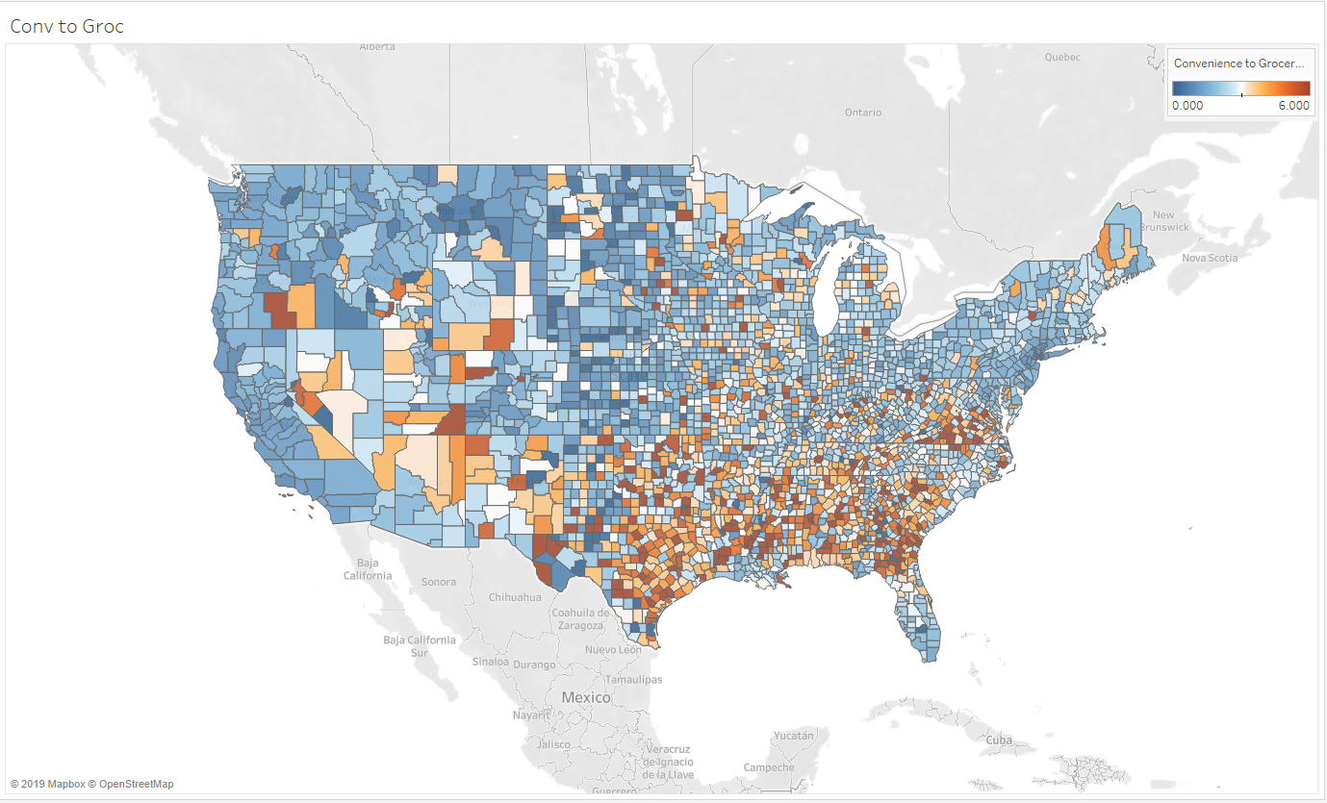
Ratio of convenience to grocery stores by county

Slide 5
The data
I identified three datasets which contained variables in which I was interested:
The United States Department of Agriculture’s Food Access Research Atlas
The Internal Revenue Service’s Statistics of Income
The American Community Survey’s 5-year estimates of educational attainment

Slide 6
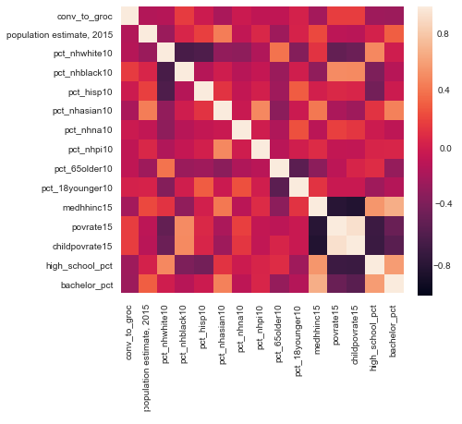
Linear correlations
Median household income has strong correlations with:
Poverty rate
Child poverty rate
High school graduated percent
Bachelor’s degree percent
The percent of the population who is non-Hispanic black is correlated with:
Poverty rate
Child poverty rate

Slide 7
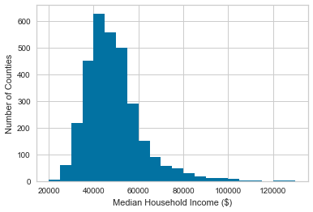
Distribution of median household income
Highly right-skewed
Minimum - $22,894
Median - $46,807
Maximum - $125,900

Slide 8
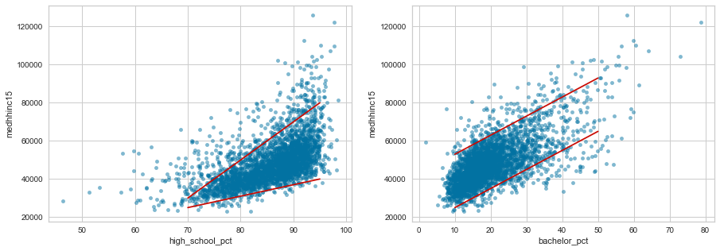
Median household income vs education
While the variation in median household income appears to grow larger as high school graduation percent increases, the variation stays fairly uniform as the percentage with a bachelor's degree changes.

Slide 9
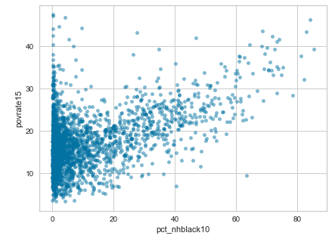
Poverty rate vs percent of population who is non-Hispanic black
The red lines mark the 75th percentile.
If these variables were independent, there should be 6.3% of counties in the upper right corner.
12.7% of counties are in this corner.
For the bottom right, we would expect 56%, but it is 63%.

Slide 10
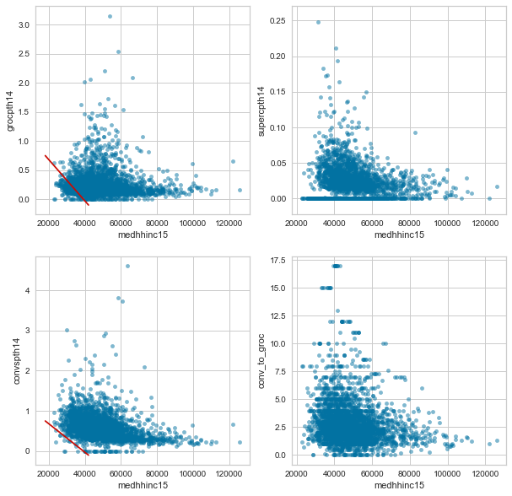
Number of stores vs median income
Grocery and convenience stores are treated differently.
For counties with a median income below 40k, the minimum number of convenience stores increases.
For grocery stores this does not happen.
The red lines show this trend.

Slide 11
Model selection
Prepared dataset for use by sklearn
Used a variety of models to find a baseline of performance
Performed feature selection and engineering
Tuned hyperparameters
Evaluated final model

Slide 12
Data preparation
Created dummy variables for the categorical variables.
Split the dataset into:
Training set – 70%
Test set – 15%
Validation set - 15%
Scaled these datasets for use in the linear models.

Slide 13
Baseline model performance
I used the Root Mean Squared Error (RMSE) to score how well a model performed on the test set.
A smaller value is better and much smaller than the standard deviation of the test set is best.
None of these models perform very well on the second metric, but gradient boosting is best.

Slide 14
Feature selection and engineering
The datasets I aggregated have the median household income as well as the percentage of tax filings in each of 8 brackets.
I tested whether these were interfering by removing each and training on the reduced features. There was no change, so I kept both in.
To create new features and control for interactions between features, I used scikit-learn’s PolynomialFeatures.
This increased the test score, so I did not keep these features.

Slide 15
Hyperparameter tuning
I used cross-validated grid search to identify the optimal values for (parameters of best scoring model)
The number of tree (50)
The maximum features considered in each split (square root)
The maximum depth of each tree (3)

Slide 16
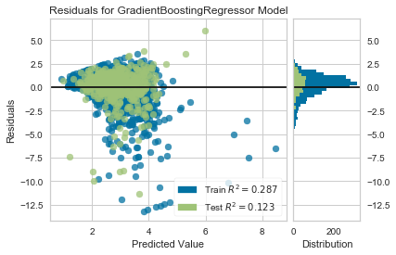
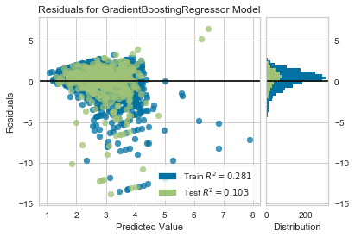
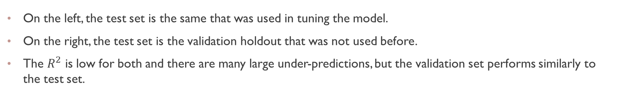
Model evaluation
On the left, the test set is the same that was used in tuning the model.
On the right, the test set is the validation holdout that was not used before.
The $R^{2}$ is low for both and there are many large under-predictions, but the validation set performs similarly to the test set.

Slide 17
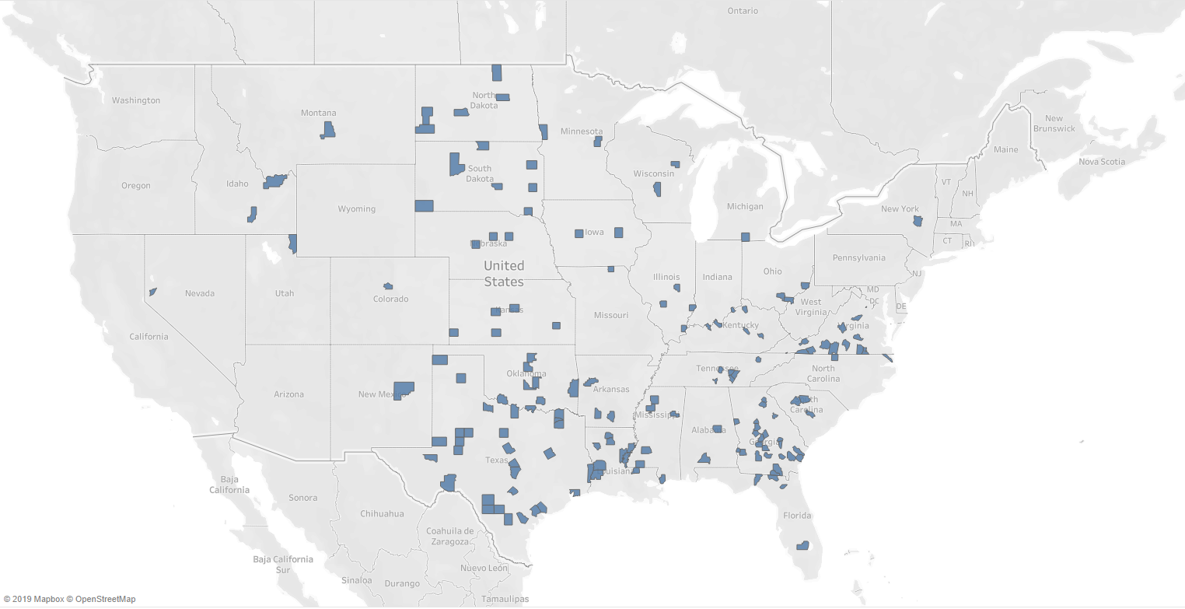
Counties with the highest ratio of convenience to grocery stores

Slide 18
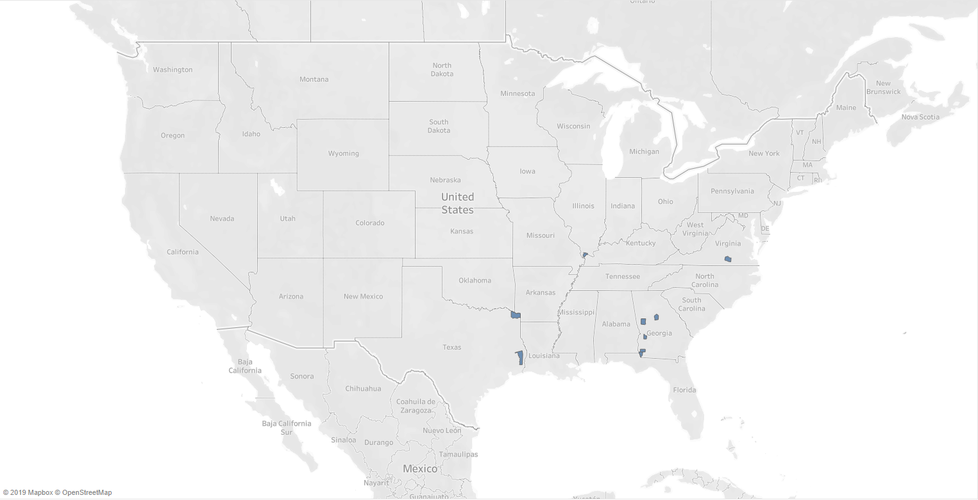
Example counties
The highlighted counties are the overlap of:
Counties in the top 5% of predicted ratios
Counties in the top 5% of residuals
Since these counties were predicted to have a large ratio, but it is below average, they may have insight on how to improve grocery store access.

